Slide 1


Notify me now
Project submission
11.02.2024

Slide 2

Team
Muhammad Qasim
(Backend Developer)
Hassan Muneer
(Frontend Designer)
Daman Ali Babar
(Database Administrator)

Slide 3

Technologies
WHAT WE USE
ReactJS Version 18.2.0 for Front End Scripting and Rendering
BootStrap Version 5.3 for Designing
Express JS Version 4.18.2 for Backend
Twilio and SendGrid for APIs for messaging
Node Mailer for sending Emails

Slide 4
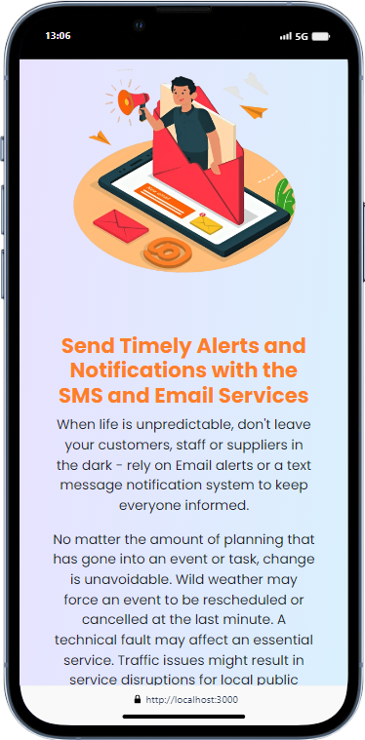
How IT LOOKs
Let’s Dive In

Slide 5
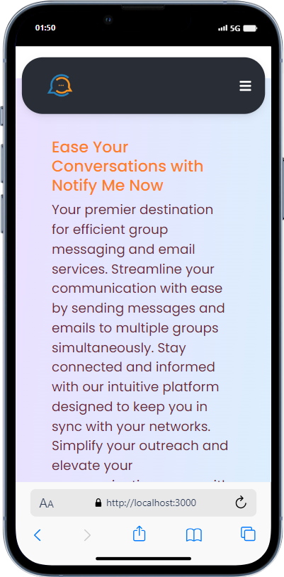
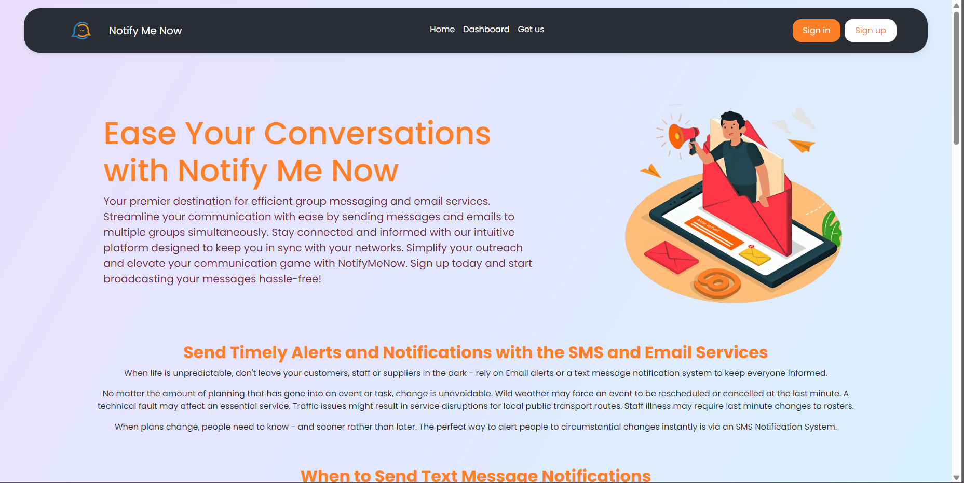
Landing page

Slide 6
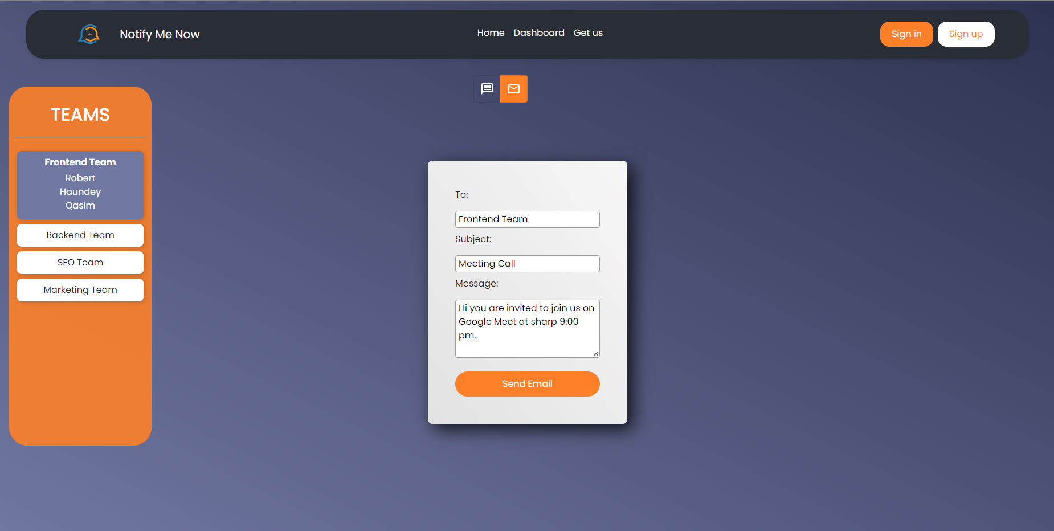
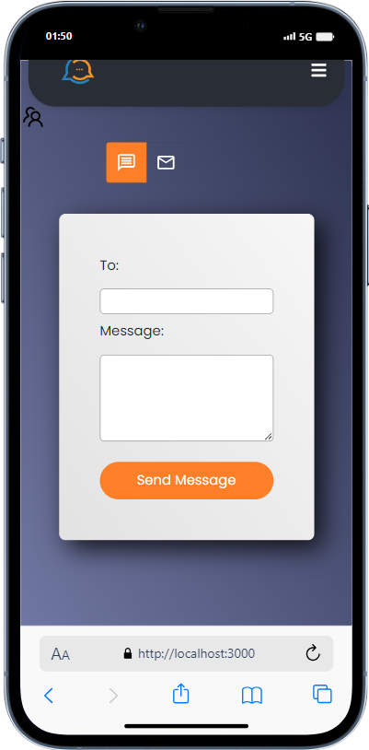
USER Dashboard

Slide 7
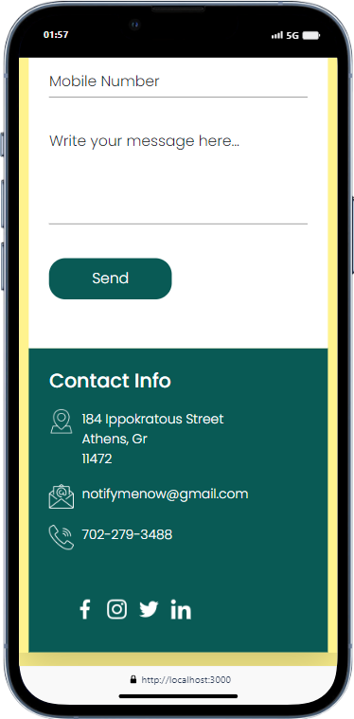
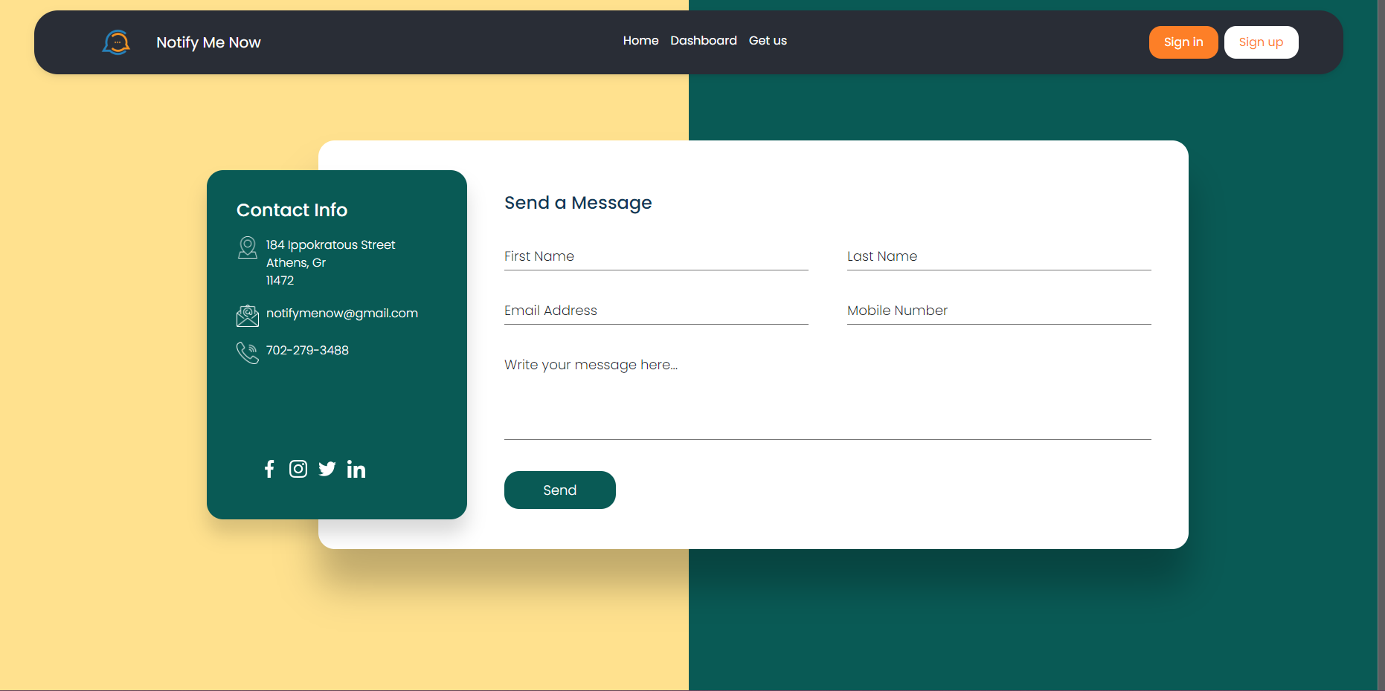
Get us

Slide 8

What’s behind
LOOKING inside

Slide 9
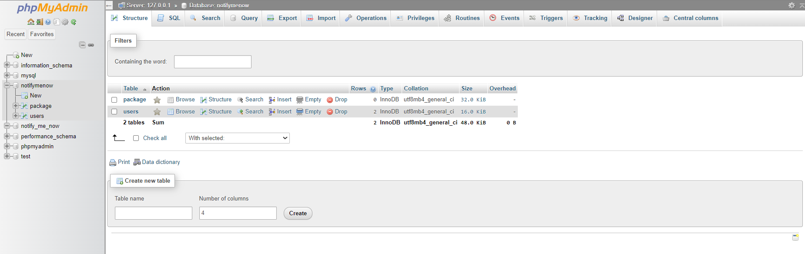
DATABASE

Slide 10
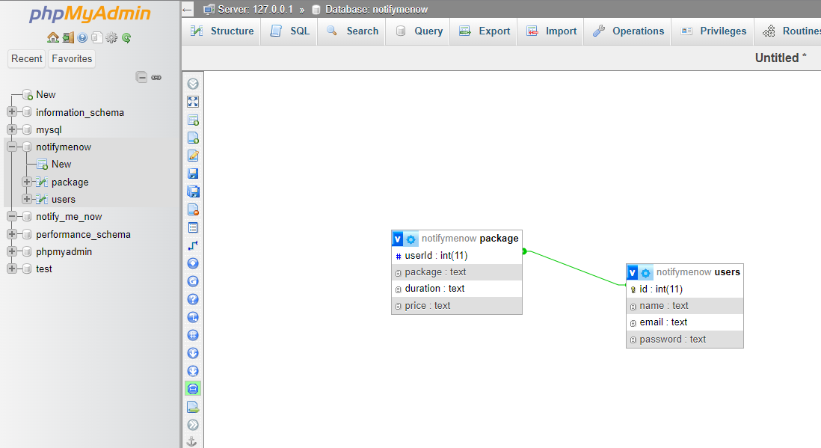
ERD FOR Database
10

Slide 11

THANKYOU!
https://github.com/MuhQasimBhatti/Notify-me-now.git

